Slide 1
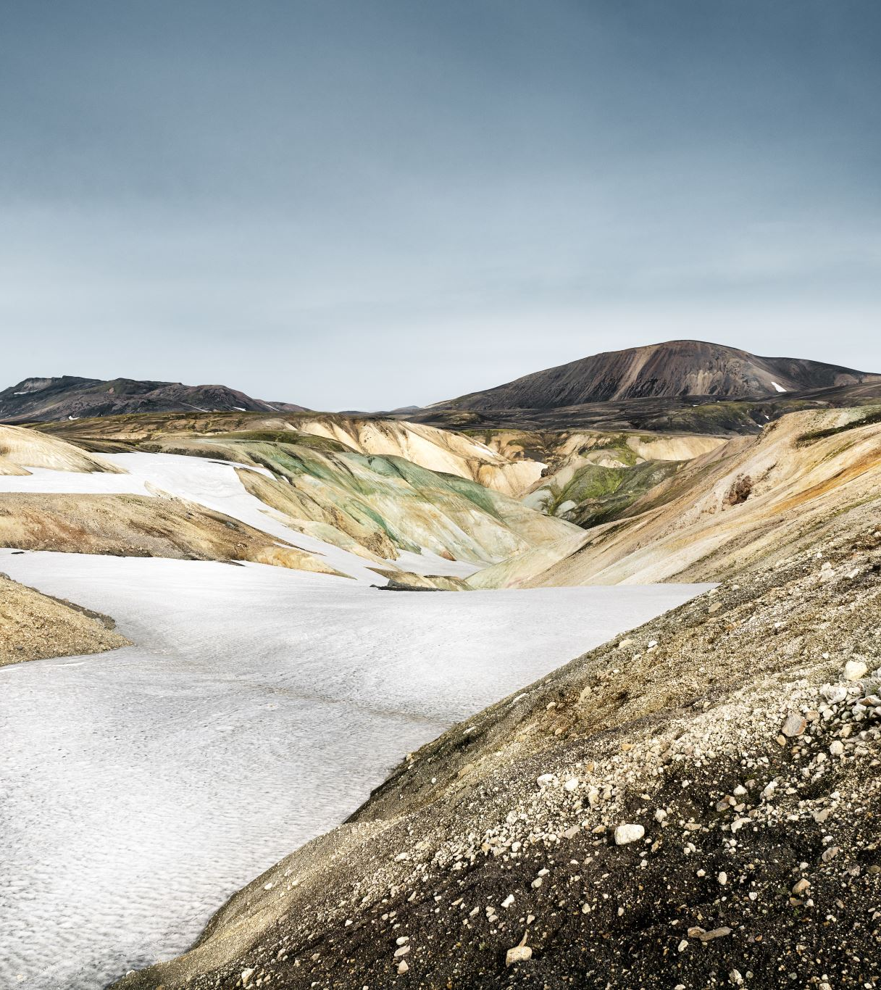
Need Finding
Stockpile validation

Slide 2
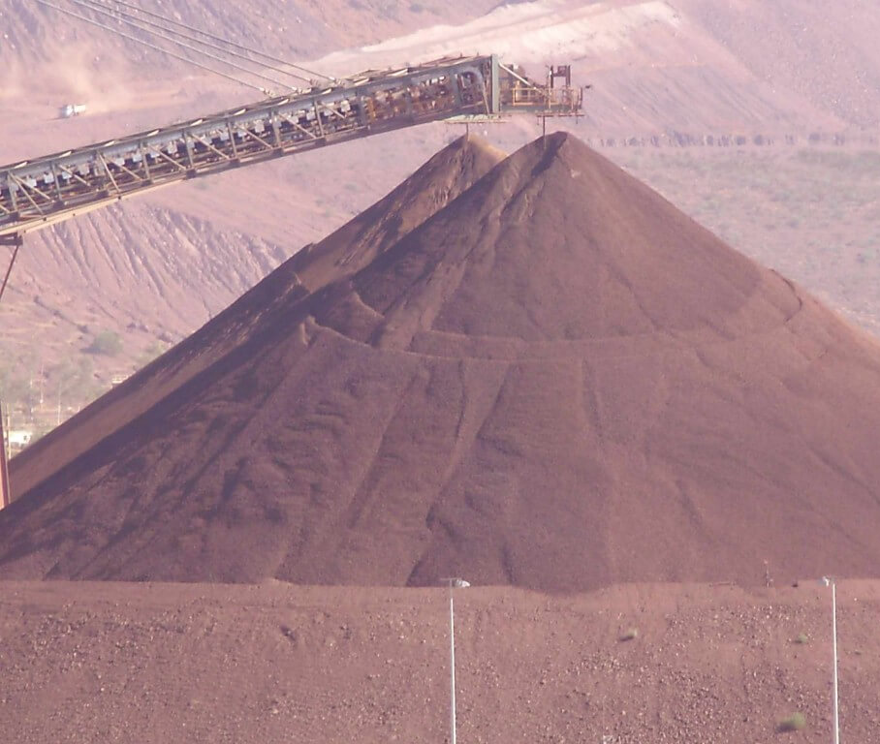
What activity did you choose to examine?
Stockpile Validation
Stockpile Surveying/Data Collection
Calculate Stockpile Volume
Generate 3D model/Digital Elevation Model (DEM)

Slide 3
How did you examine it, with what methods?
Interview
Online research through videos how surveying is done
Witness first hand the equipment used by professional surveyors

Slide 4
What major insights or breakdowns did you discover?
Data Acquisition is slow because of the following reason:
The equipment is heavy, bulky and expensive
The object being surveyed is huge and uneven in shape
The environment is harsh
Due to time constraint, surveyors do random sampling to represent the whole stockyard which affects the accuracy
Safety concern of the surveyors
Generating output which is volume and its 3D model requires:
Expertise of the Computer Aided Design Software

Slide 5
What promising unmet needs were identified as a result?
Volume Validation would be easier, more efficient, and more accurate if there will be a device that will use remote sensing technology and can conduct the data collection aerially.

